Slide 1

Systematic Reviews and Meta-analysis
Stephanie Blasick, DO
Pediatric Hospitalist

Slide 2

Objectives
Demonstrate understanding of general EBM principles associated with Therapy articles and Systematic Reviews.
Refresh on board relevant EBM terms for Therapy studies.
Demonstrate understanding of validity measures specific to systematic review articles.
Critically appraise a systematic review and describe its clinical applicability.

Slide 3

Clinical Scenario
You are caring for a former 25 week premature 3 month old female currently admitted to the acute care floor for viral bronchiolitis. She is 6kg and on 12L HFNC. She is receiving frequent suctioning and IV fluids. She continues to have worsening respiratory distress and is started on scheduled albuterol and solumedrol for suspected BPD/CLD exacerbation. She is undergoing transfer to the PICU when the intensivist asks you to start scheduled budesonide.

Slide 4

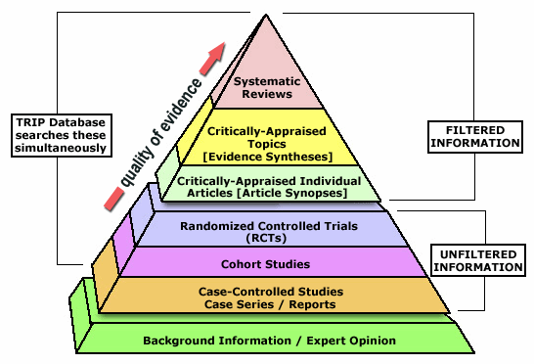
Systematic reviews are high quality evidence

Slide 5

Systematic reviews: what are they
The identification, selection, appraisal, and summary of primary studies addressing a focused clinical question (PICO) using methods to reduce the likelihood of bias
Bias: systematic deviation from the underlying truth because of a feature of the design or conduct of a research study; many different types of bias
Minimize random error by amassing very large numbers

Slide 6


Slide 7

Systematic Reviews: why do they matter
Single studies may not represent a total body of evidence, which may make their results misleading
Collecting and appraising a number of studies take TIME
They are usually accompanied by a meta-analysis to provide the best estimate of effect that increases precision and facilitates decision making
If performed well, they may provide all the relevant evidence with an assessment of best estimate of effect and warranted confidence
They include a greater range of patients than a single study, which may enhance confidence in applying the results to current patient

Slide 8

Systematic reviews: where to find them
In most journals
Cochrane reviews
Clinical Queries on PubMed (note that not all reviews are SYSTEMATIC reviews)
They aren’t on UptoDate, but are frequently referenced on UptoDate

Slide 9
So there are other reviews?
Narrative Reviews
Seldom report clinical questions, addresses several general questions
Seldom report search for articles, not comprehensive
Seldom report selection criteria and often biased sample
Quality of studies seldom reported and usually not systematically evaluated
Usually qualitative nonsystematic summary
Ex: Peds in Review articles
Ex: Recent evidence on the management of bronchiolitis Current Opinion in Pediatrics
Systematic Reviews
Focused question, often PICO
Comprehensive search of several evidence sources
Explicit inclusion and exclusion criteria for primary studies
Methodologic quality of primary articles is assessed, to limit bias
Synthesis of results is systematic (qualitative or quantitative, may be meta-analysis)
Ex: Cochrane database
Ex: Nebulized hypertonic saline solution for acute bronchiolitis in infants Cochrane

Slide 10

Meta-analysis: what is it
A statistical technique for quantitatively combining the results of multiple studies measuring the same outcome into a single pooled or summary estimate
Pooling of data increases precision and narrows confidence intervals
Often systematic reviews include meta-analysis

Slide 11

REMINDER: Confidence Interval vs. P-value
CI- Range of values within which it is probable that the true value of a parameter lies
Gives results with a margin of error (since no trial is perfect or done with the entire population)
P-value- The probability that results as extreme as or more extreme than those observed would occur if the null hypothesis were true and the experiment were repeated over and over

Slide 12

Why do we need Confidence Intervals?
We can’t study everyone in the population
CI tells us that if the same study were carried out 100 times on a similar population of patients the mean would fall within the measured CI 95 times.
We cannot know for certain whether or not the TRUE population mean lies within the calculated 95% CI.
If there is systematic bias in the study, then the 95% CI likely does not contain the true mean value.

Slide 13

Confidence Intervals
You take 15 people with disease X and give them a study drug. 5 of them get better.
Does that mean 33% of all people with disease X who are given the study drug will get better? Not necessarily.
What about chance? What if you happened to pick 15 people with a worse or better prognosis at baseline?
Need CI to help statistically apply our data to the overall population rather than just the sample in our study

Slide 14
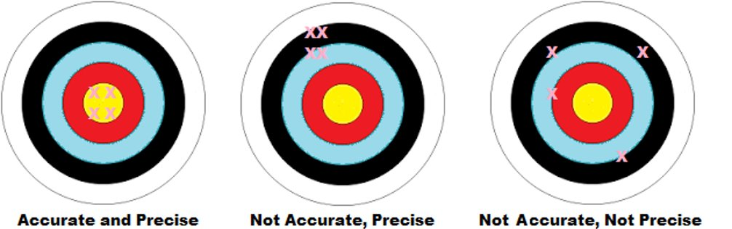
Confidence Intervals
With a 95% CI, the CI defines the range that includes the true parameter 95% of the time.
Give a measurement of precision
Narrow CI more precise than wide CI

Slide 15

Confidence Intervals
Width of a CI is largely due to sample size
Small sample sizes will have larger CI and larger sample sizes will have smaller CI (because less is left to random chance)

Slide 16


95% CI
Similar to a p-value of 0.05
It is correct to say that if the true value lies outside the 95% CI, the likelihood of obtaining the data observed in the study is 5% or less

Slide 17

Why do we need Confidence Intervals?
The range of the CI will give you clinically relevant information that a P-value won’t
P-value just says statistically significant, but says nothing about clinical value
Most journals advocate for using a CI because of the clinical significance

Slide 18

How do we minimize bias?
Randomly allocate patients to one group or another
Blind patients and investigators
Focus on endpoints that are concrete (death, change in lab value, etc)
Ensure complete follow up
Complete study as initially planned
Intention to treat

Slide 19

Intention To Treat Analysis
Based on the initial treatment intent, not on the treatment eventually administered.
Intended to avoid various misleading events that can arise in intervention research.
For example, if people who have a more serious illness tend to drop out at a higher rate, even a completely ineffective treatment may appear to be providing benefits if you only compare those who finish the treatment with all those who did not.
For the purposes of ITT analysis, everyone who begins the treatment is considered to be part of the trial, whether they finish it or not.
Minimizes bias

Slide 20

Bias vs Random Error
Random Error– an error that has random distribution and can be attributed to chance
Ex. Though the probability of getting heads when flipping a coin is 50%, every 10 coin flips will not be 5 head and 5 tails
This is why we can never be completely sure of true treatment effect regardless of how well designed and powerful an experiment is.
This is where p-values, confidence intervals, and sample size come into play

Slide 21

Steps in Systematic Review
Formulate
Formulate a good question
Locate
Locate studies with good selection criteria
Appraise
Appraise the quality of studies (assess validity and replicability)
Combine
Combine the results
Interpret
Interpret the results

Slide 22

Systematic review appraisal
Are the results valid?
What are the results?
Are they applicable to my patient/population?

Slide 23

Are the results valid?
Is this a systematic review of randomized trials?
Systematic Reviews of Non-Randomized Trials Can:
- Compound the problems of individually misleading trials
- Produce a lower quality of evidence
If a systematic review includes both Randomized and Non-Randomized Trials, avoid it unless these types of trials are separated in the analyses.

Slide 24

Are the results valid?
Were the results consistent from study to study?
Does the study have a Methods Section
Seek a description of how the investigators found all the relevant trials
This may be presented in a flow diagram
If not present -> STOP

Slide 25

The Methods Section
Seek reassurance that the search went beyond standard bibliographic databases
Should include hand-searching journals, conference proceedings, theses, databanks of pharmaceutical companies, and contacting authors of published articles
Negative trials are less likely to be submitted and selected for publication
A Systematic Review restricted to published trials can result in a false-positive conclusion
Restriction to a single language can bias the conclusions

Slide 26

Are the results valid?
How did the investigators assess the validity of the individual studies?
Randomized?
Follow-Up sufficient?
Intention to treat analysis?
Blinded?
Were the groups similar at the start?
Were the groups treated equally, apart from the experimental tx?

Slide 27
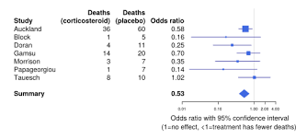
What are the results?
Forest Plots
Each study is a line
Vertical line is point of no difference
Horizontal line is 95% confidence interval
“Blob” or squares are mean estimate of truth for each study. Size is based on weight which is based on sample size AND event rate
Diamond is summary mean. Horizontal corners are its CI and vertical are its mean.

Slide 28
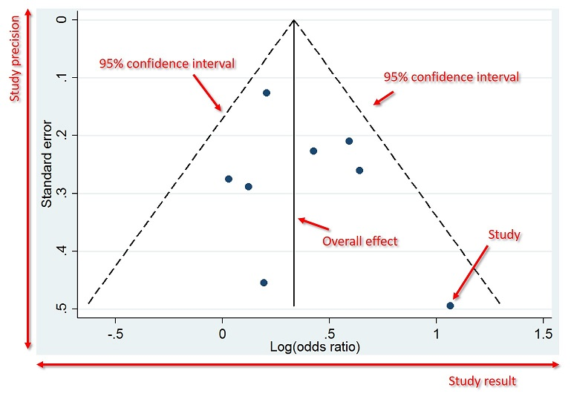
What are the results?
Funnel Plots and Publication Bias
Vertical Axis
Measure of study precision
Higher up: more precise, smaller CI
Horizontal Axis
Measures treatment effect
Center Line
Combined treatment effect
No publication bias: Inverted funnel shape
Reminder: The OR represents the odds that an outcome will occur given a particular exposure, compared to the odds of the outcome occurring in the absence of that exposure.
OR=1 Exposure does not affect odds of outcome
OR>1 Exposure associated with higher odds of outcome
OR<1 Exposure associated with lower odds of outcome

Slide 29

Are the results applicable to my patient?
Is our patient so different from those in the study that the results cannot apply?
Is the treatment feasible in our setting?
What are our patient’s potential benefits and harms from the therapy?
What are our patient’s values and preferences for both the outcome we desire and the potential side-effects of treatment?

Slide 30

A comment on Heterogeneity
A Systematic Review provides an overall, average effect of therapy which may be derived from a heterogeneous population.
SR’s may provide precise information on sub-groups that may help individualize evidence to our own patients.
BUT...

Slide 31

Subgroup Analysis
A qualitative difference in treatment efficacy among subgroups is likely only when ALL the following questions can be answered “YES”:
Does it really make biological and clinical sense?
Is the qualitative difference both clinically and statistically significant?
Was it hypothesized before the study began (rather than a product of dredging the data) and has it been confirmed in other independent studies?
Was it one of just a few subgroup analyses carried out in this study?
Subgroup analysis: Should be used more as hypothesis generating tools as may not truly be showing a difference since derived from aggregate data
Can show a difference when there really isn’t one due to chance

Slide 32

Let's practice

Slide 33
Clinical Scenario
You are caring for a former 25 week premature 3 month old female currently admitted to the acute care floor for viral bronchiolitis. She is 6kg and on 12L HFNC. She is receiving frequent suctioning and IV fluids. She continues to have worsening respiratory distress and is started on scheduled albuterol and solumedrol for concern for BPD/CLD exacerbation. She is undergoing transfer to the PICU when the intensivist asks you to start scheduled budesonide.

